Slide 1
MODULE 2: Algorithm, Pseudocode, and Flowchart
PTP5.101: Programmer's Mindset: Problem Solving and Programming

Slide 2
Algorithm
Definition of Algorithm
Properties of Algorithm
Representation of Algorithm

Slide 3
Algorithm
An algorithm is a finite, ordered set of well-defined instructions that, when executed, perform a task or solve a problem.
Algorithms are abstract, meaning they can be implemented in multiple programming languages or even by non-computerized processes.
The steps in an algorithm must be clear and unambiguous.

Slide 4
Properties of an Algorithm
Finiteness: It should terminate after a finite number of steps.
Definiteness: Each step must be precisely defined; instructions should be unambiguous.
Input: Algorithms may take zero or more inputs.
Output: They produce at least one output.
Effectiveness: Every step in the algorithm must be basic enough to be carried out with minimal resources.

Slide 5
Algorithm Example1
Suppose you are given a set of mark sheets, each bearing A, B, C, or F letter grades.
Write an algorithm to read the mark sheet and print the grade associated.
Start
Take a mark sheet and
read the grade.
Print the grade
Stop

Slide 6
Algorithm Example2
Suppose you are given a set of mark sheets, each bearing A, B, C or F grades.
Write an algorithm to read a mark sheet and print the grade if the grade is A only.
Start
Take a mark sheet and read the grade.
If the grade is A then Print the grade
Stop

Slide 7
Algorithm Example3
Suppose you are given a set of mark sheets, each bearing A, B, C or F grades.
Write an algorithm to read a mark sheet and print the grade if it is A or B only.
Start
Take a mark sheet and read the grade.
If the grade is A or B then Print the grade
Stop

Slide 8
Representation of Algorithm
A pseudo-code
A flowchart
Programs statements in a programming language.
Pseudo-code Example 1
Start
Take a mark sheet and read the grade.
Print the grade
Stop
Pseudo-code Example 2
Start
Take a mark sheet and read the
grade.
If the grade is A then Print the grade
Stop

Slide 9
Pseudocode
Definition of Pseudocode
Pseudocode Structure
Purpose and Requirement of Pseudocode
Basic Syntax and Conventions
Structure and Conventions
Advantages and Disadvantages

Slide 10
Pseudocode
Pseudocode is another program analysis tool that is used for planning program logic.
"Pseudo" means imitation or false
"Code" refers to the instructions written in a programming language.
Pseudocode is a way to describe algorithms and program logic in a language-agnostic format that resembles structured human language.
It combines English words with programming structures, creating a readable blueprint for code.

Slide 11
Common Control Structures
Common Control Structures in Pseudocode
Sequential Flow: Execute instructions one after another.
Example:
SET a = 5
SET b = 10
DISPLAY a + b
Decision Structures (If-Else): Direct the flow based on conditions.
Repetition Structures (Loops): Include structures like FOR, WHILE, and REPEAT UNTIL.
Function Calls: Invoke reusable functions or procedures for modular code.

Slide 12
Purpose of Pseudocode
Planning: Helps to outline and structure algorithms before coding.
Communication: Allows developers to explain algorithms in a simple, readable way.
Problem Solving: Aids in logically solving a problem by breaking it down into steps.
Implementation Guide: Serves as a preliminary version of the actual code, simplifying the coding phase.

Slide 13
Requirements of Pseudocode
Clarity: It should be easy for both programmers and non-programmers to understand.
Abstraction: Pseudocode abstracts away language-specific syntax while focusing on the core algorithm.
Logic-Driven: Emphasizes the flow of control and decision-making in the algorithm.
Structured Approach: Uses standard constructs like loops, conditionals, and functions to show logic flow.
No Language Dependency: Pseudocode should be written in plain language without relying on syntax of specific programming languages.
No Syntax Rules: There’s no strict rule for pseudocode syntax, but consistency in style is important.

Slide 14
Basic Syntax and Conventions
Basic Keywords: These are the fundamental keywords to indicate actions, operations, and structures.
Variable Assignment:
SET or LET: Used to assign values to variables.
Example: SET total = 0
Input/Output:
INPUT or READ: For reading input from the user.
Example: INPUT number
DISPLAY or PRINT: For displaying output to the user.
Example: DISPLAY "The result is ", result

Slide 15
Basic Syntax and Conventions
Control Flow Keywords:
Conditional Statements:
IF, THEN, ELSE, ELSE IF, END IF: For decision-making.
Example:
IF score >= 50 THEN
DISPLAY "Pass"
ELSE
DISPLAY "Fail"
END IF

Slide 16
Basic Syntax and Conventions
Looping Statements:
FOR, END FOR: Used for a fixed number of iterations.
Example:
FOR i = 1 TO 10
DISPLAY i
END FOR
WHILE, END WHILE: For loops based on a condition.
Example:
WHILE counter < 5
DISPLAY counter
SET counter = counter + 1
END WHILE

Slide 17
Basic Syntax and Conventions
REPEAT… UNTIL: Used for loops that repeat until a specific condition is met.
Example:
REPEAT
DISPLAY "Processing...“
UNTIL isComplete = true

Slide 18
Basic Syntax and Conventions
Functions and Procedures:
FUNCTION, RETURN, END FUNCTION: For reusable blocks of code that produce a value.
Example:
FUNCTION Sum(a, b)
RETURN a + b
END FUNCTION

Slide 19
Basic Syntax and Conventions
PROCEDURE, END PROCEDURE: For blocks that perform actions without returning a value.
Example:
PROCEDURE DisplayMessage(message)
DISPLAY message
END PROCEDURE

Slide 20
Basic Syntax and Conventions
Error Handling (optional): Sometimes, pseudocode includes basic error-handling keywords.
TRY, CATCH, END TRY: Handles possible errors.
Example:
TRY
SET result = num1 / num2
CATCH ZeroDivisionError
DISPLAY "Cannot divide by zero"
END TRY

Slide 21
Structure and Conventions
Indentation and Hierarchical Structure: Indent nested structures to indicate hierarchy (e.g., conditionals within loops).
Consistency in Keywords: Use standard keywords and maintain a consistent style throughout the pseudocode.
Capitalization of Keywords: Often keywords like IF, FOR, WHILE are capitalized to distinguish them from other parts.
Descriptive Variable Names: Use descriptive names like totalPrice, userName, and score instead of generic ones like x or y.
Comments: Include comments (// or /* … */) to clarify complex logic, especially for larger pseudocode structures.

Slide 22
Best Practices in Writing Pseudocode
Keep It Simple: Avoid unnecessary detail. Focus on logic and structure, not exact syntax.
Use Comments for Complex Logic: If there are specific parts of the pseudocode that are not straightforward, add comments to explain.
Consistent Formatting: Maintain consistency in indentation, naming conventions, and structure to improve readability.
Modularize with Functions and Procedures: Break down complex logic into functions to make the pseudocode easier to read and understand.
Avoid Language-Specific Terms: Stick to general terms so that the pseudocode can be easily implemented in any language.

Slide 23
Merits of Pseudocode
Writing of pseudocode involves much less time and effort than drawing an equivalent flowchart.
Converting a pseudo code to a programming language is much more easier as compared to converting a flowchart.
It is easier to modify the pseudocode of a program logic when program modifications are necessary.

Slide 24
Limitations of Pseudocode
In case of pseudocode, a graphic representation of program logic is not available.
There are no standard rules to follow, in using pseudocode.
Different programmers use their own style of writing pseudocode
Communication problems occur due to lack of standardization.
For a beginner, it is more difficult to follow the logic or write the pseudo code, as compared to flowcharting.

Slide 25
Flowchart
Definition of Flowchart
History of Flowchart
Use of Flowchart
Types of Flowchart
Basic Symbols and their Explanation
Working with Flowchart
Advantages and Disadvantages

Slide 26
Flowchart
A flowchart is a diagram that depicts the stages of a process, workflow, computer program or system.
Flowchart diagrams consist of shapes connected by lines and represent step-by-step processes to aid in decision-making, reduce ambiguity and enhance workflows.
Software developers create flowcharts to plan the logical steps in the computer software and algorithms they create.

Slide 27
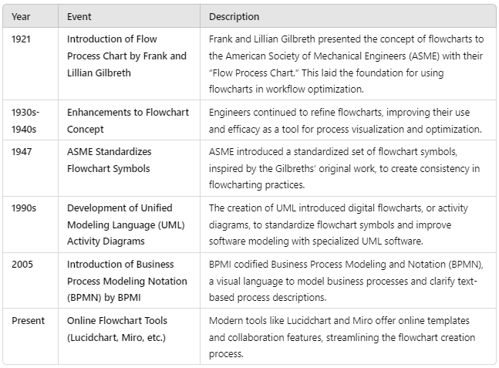
History of Flowchart

Slide 28
Flowchart
What are flowcharts used for?
People use flowcharts to visualize, design and document a countless range of processes and procedures.
A flowchart can aid in any of these tasks:
Documenting a process or procedure
Brainstorming ideas
Business process management (BPM) and business process analysis (BPA)
Increasing clarity and improving communication between colleagues and teams
Outlining a decision-making procedure
Clarifying the reporting structure of an organization
Optimizing a process or workflow
Explaining how a process is done

Slide 29
Flowchart Types
What types of flowcharts are there?
Though all flowcharts follow the same basic format, different types of flowcharts are tailored to specific contexts. The following flowchart examples are some of the more common flowchart types in use today.
Program Flowcharts
System Flowcharts
Workflow Diagrams
Decision Flowcharts
Data Flow Diagrams (DFD)
Process Flow Diagrams (PFD)
Swimlane Diagrams
Organizational Charts

Slide 30
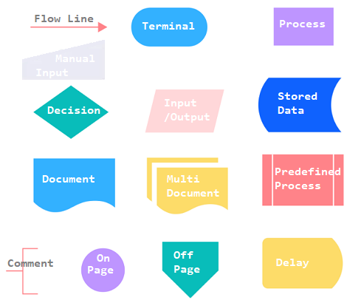
Common Flowchart Symbols

Slide 31
Symbol Explanation
Flowline Connects steps in the flowchart, showing progression and sequence with arrows, sometimes with additional text.
Terminal Indicates the starting or ending point of the process, with some flowcharts having multiple terminal symbols.
Process Depicts a step in the process sequence, instructing users to complete it before continuing.
Decision Marks a point where a choice must be made, usually with multiple paths based on a yes/no or true/false answer.
Input/output (data) Represents points where data enters or exits the process, shown with a parallelogram symbol.

Slide 32
Symbol Explanation
Stored data Shows where data is stored within the process, often represented as a database or storage (cylinder).
Document Indicates the receipt or generation (input or output) of a document, like an order form or report.
Multi-document Similar to Document but represents multiple documents generated or received at a single process stage.
Predefined process Points to an established process located outside the current flowchart. Subroutine.
Comment/annotation Provides extra context, instructions, or clarification related to a specific process step.

Slide 33
Symbol Explanation
On-page connector Connects flowchart steps that are far apart on the same page for readability.
Off-page connector Links to a process on a different page, used in multi-page flowcharts for continuity.
Delay Indicates a waiting period in the process, often noting the delay duration.
Alternate process Represents a secondary or alternative process option, typically with dashed flowlines leading to it.

Slide 34
Symbol Explanation
Preparation Shows steps required to set up or prepare for the next process in the flowchart.
Display Indicates where and how information is displayed as part of the process.
Manual input Highlights a process step requiring manual action, as opposed to automated steps.

Slide 35
Flowchart Example1

Slide 36
Flowchart Example2

Slide 37
Advantages of Flowchart
Conveys Better Meaning
Analyses the Problem Effectively
Effective Joining of a Part of a System
Efficient Coding
A group of programmers are normally associated with the design of large software systems. Each programmer is responsible for designing only a part of the entire system. So initially, if each programmer draws a flowchart for his part of design, the flowcharts of all the programmers can be placed together to visualize the overall system design. Any problem in linking the various parts of the system can be easily detected at this stage and the design can be accordingly modified. Flowcharts can thus be used.
Systematic Testing

Slide 38
Disadvantages of Flowchart
Time-Consuming:- Takes More Time to Draw
Non-standardization:- No standards determining the amount of detail that should be included in a flowchart.
Difficult to Make Changes:- Owing to the symbol-string nature of flowcharting, any changes or modifications in the program logic will usually require a completely new flowchart. Redrawing a flowchart is tedious.

